Slide 1

Welcome to Kinder Class!
Mrs Elliff is in school Monday, Tuesday with Mrs Shorney
Mrs Rhodes is in school on a Wednesday, Thursday and Friday.
With Mrs Aldred.
Mrs Roberts is the headteacher.

Slide 2
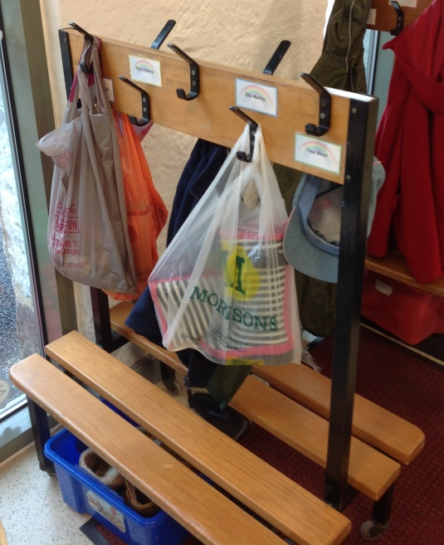
What do we do when we arrive at school?
Start date:
Friday 6th September
(4th and the 5th are training inset days)
Adults bring children onto the playground through the green gate for the first day.
Then drop off at the gate after that.
When we arrive at school children will put:

Slide 3
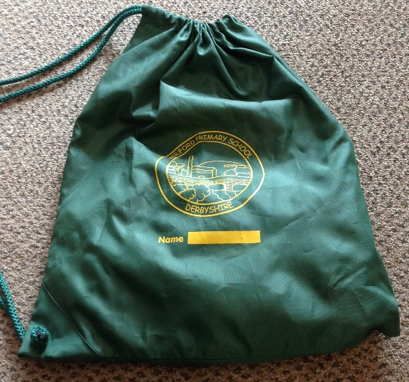
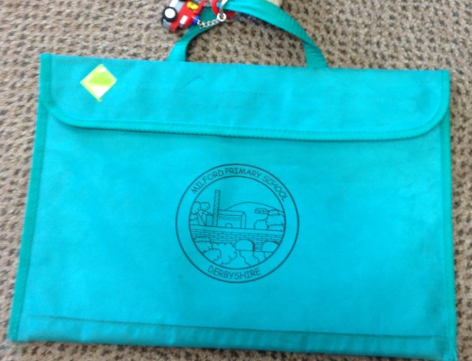
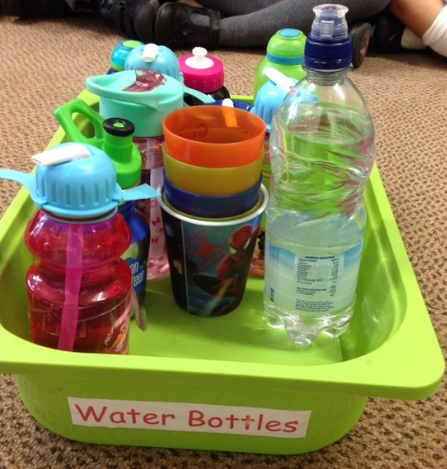
What do we bring into school?
Water bottle every day.
Book bags every day.
Spare clothes (can be left in a bag on peg).
Monday and Fridays
P.E kit
Wednesday – woods
Weather appropriate clothes
Wellies and water proofs.

Slide 4
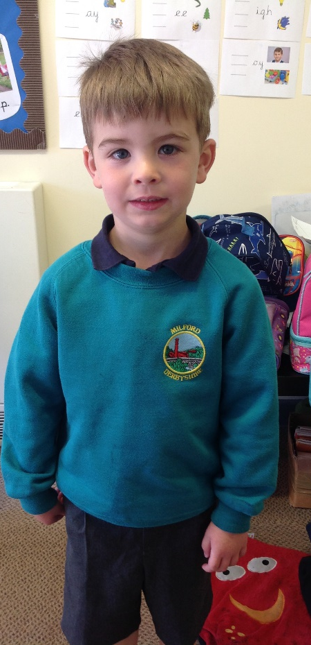
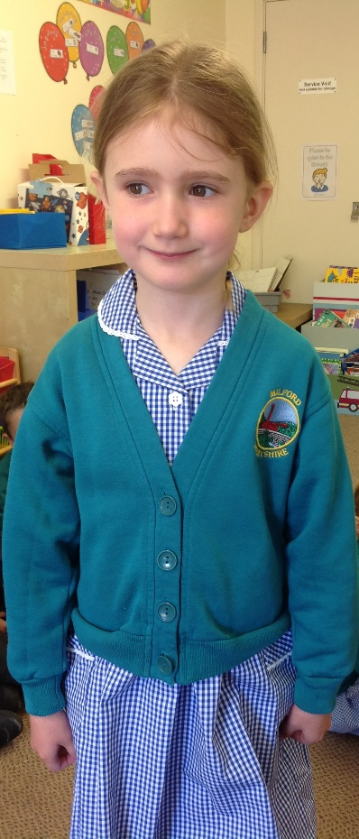
What do we wear to school?
Need to put child’s name in ALL clothing items including PE kit.
Black shoes / black trainers
Waterproof coat, every day.
Winter – scarves, gloves and hats.
Summer – sun hats and labelled sun cream.
No jewellery, only stud earrings.

Slide 5
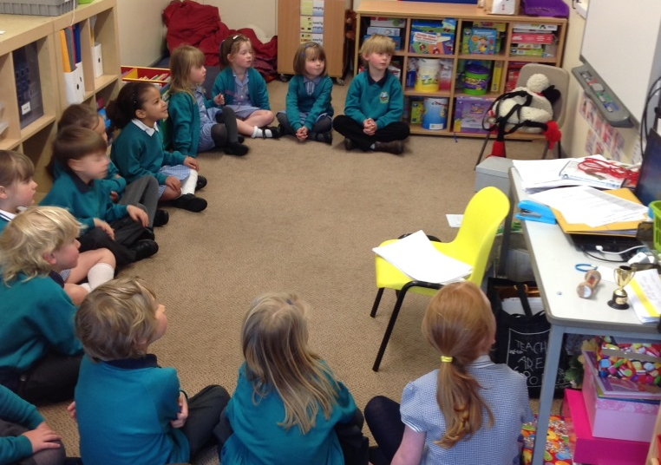
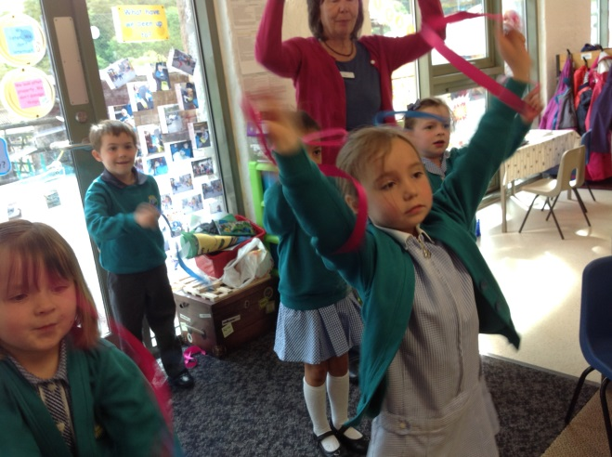
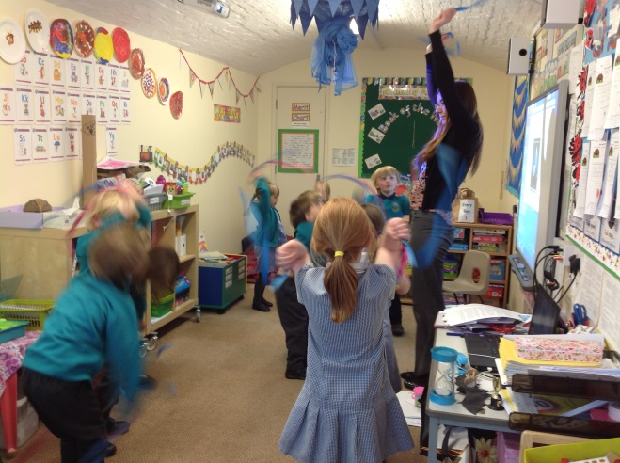
What do we do at school?
Register,
Phonics,
Funky Fingers,
Drawing club,
Maths
Snack time,
Reading,
PE,
Assemblies.

Slide 6
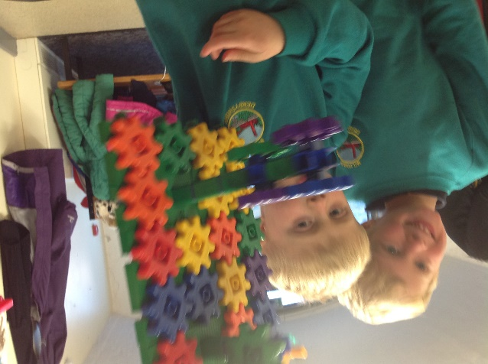
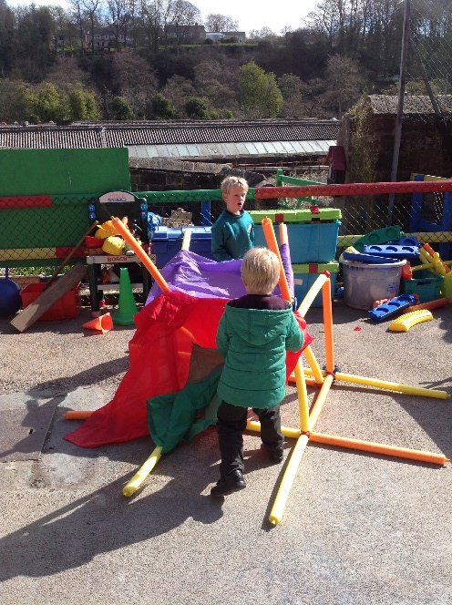
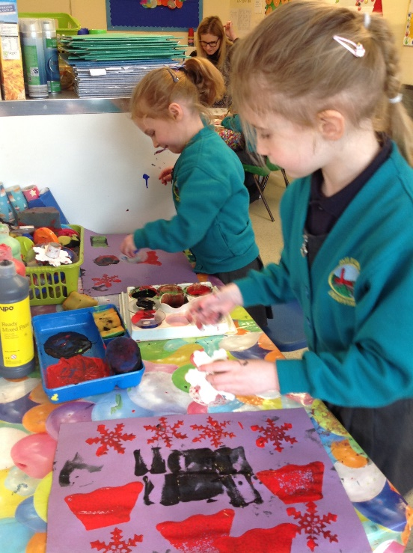
We have all kinds of fun!
Outdoor area. (mud kitchen, bikes and sports
equipment, role play area, water play, climbing frame )
Inside area is sectioned. (creation station, role
play, Messy/malleable play, sand play as well as
Writing phonics and maths areas
Lots of different Topics/themes.
Trips during the year.
(woods, sports, singing, visit the
Church)
Visitor in school too!

Slide 7
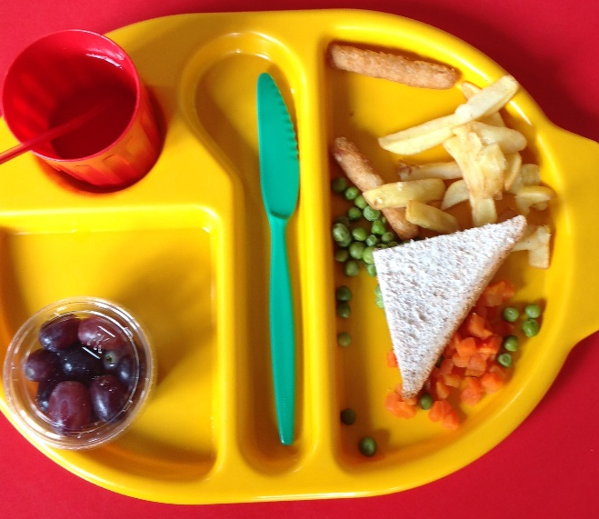
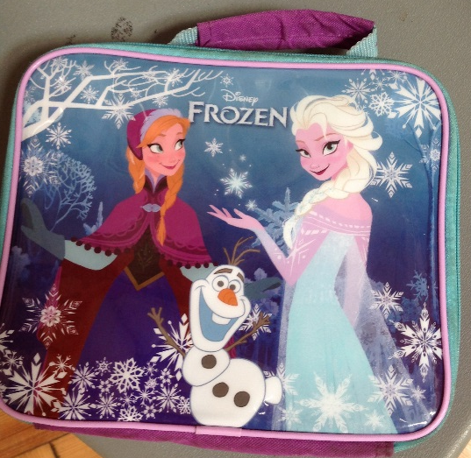
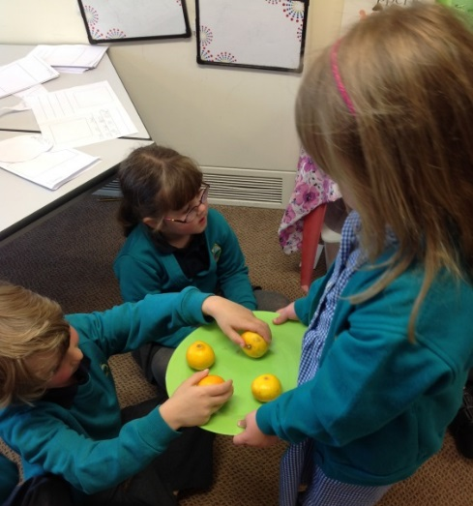
Snack Time and Lunch time
Snack is able to be taken throughout the day.
Lunch time at 12.00. School dinners are free for under 7s or a packed lunch with name on. Nut Free
In the Mornings we have milk with snack. Children under the age of 5 get free milk, once a child turns 5 they can still have milk but parents will need to pay for it.

Slide 8
Foundation Stage Profile
EYFS Statutory Curriculum most of which is set out in our continuous provision.
Early Years Foundation Stage 2 is organised into 7 areas of learning
    Communication and Language
    Personal, Social and Emotional Development
    Physical Development. (gross and fine motor)
    Literacy
    Mathematics
    Understanding the World
    Expressive Arts and Design

Slide 9




Schemes we use in school

Slide 10
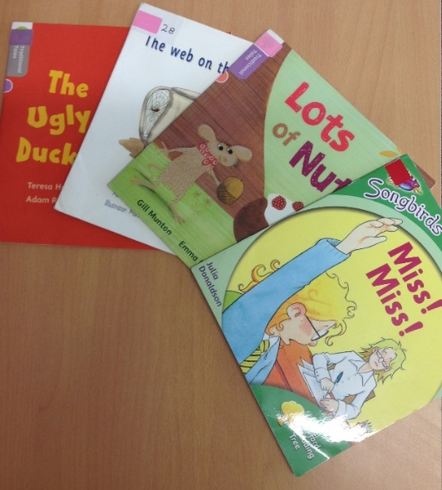
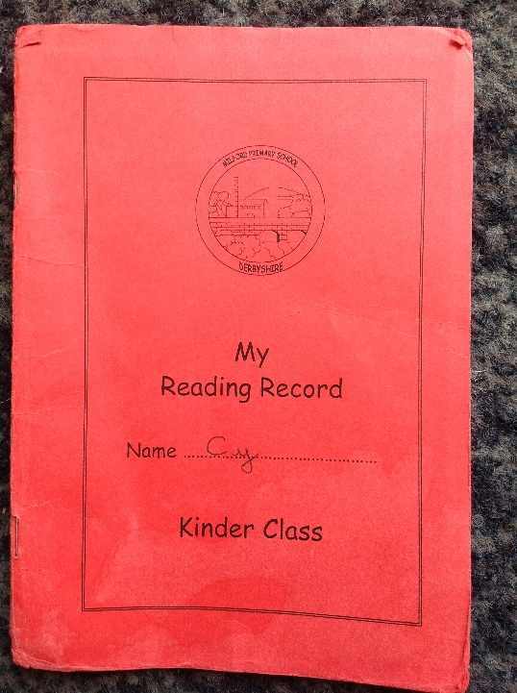
Involving Parents
Reading diaries.
Reading books.
Words, numbers, sounds.
Home work.
Proud Moments.
Adults can see us after school to talk or arrange a meeting.
Parents evenings.
Tapestry.
End of year reports.
Parent helpers – come in and help out in the classroom! Or on trips !

Slide 11
Practical Details
Name labels in all clothes including PE kits.
Children need to have a coat in school every day.
Packed lunches in named lunch box.
(No chocolate, sweets, fizzy drinks, water only in water bottle.)
Fruit is provided for snack time. Children can also bring in snack if they prefer
Spare clothes in case of accidents/ messy wet play.
We don’t have a lot of space so we would prefer it if toys from home were not brought into class.

Slide 12
Key Skills for School – things to work on at home over the holidays
Cutting and sticking.
Recognising their name (no need to write their name).
Being able to hold a pencil correctly.
Recognise all/some numbers to 10/20.
Recognise the common shapes (circle, square, rectangle, triangle).
Be able to put their coat on.
Be able to get themselves dressed and undressed for PE.
Recognise and name the colours.
Go to the toilet independently.
Be able to use a knife and fork independently.
Be able to tell an adult when they need something.

Slide 13
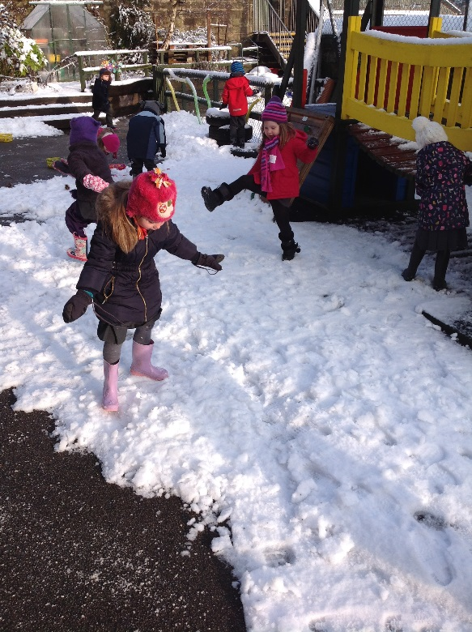
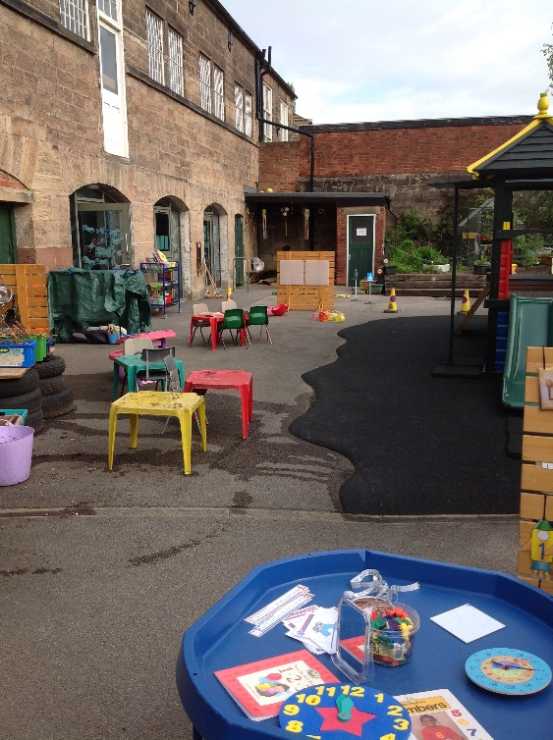
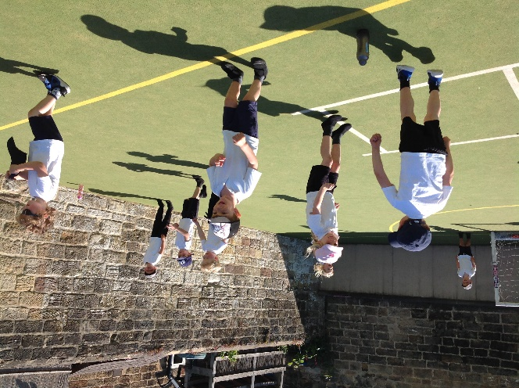
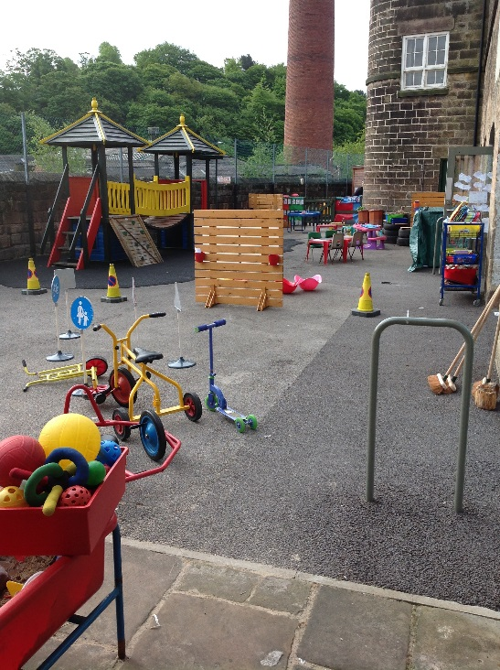
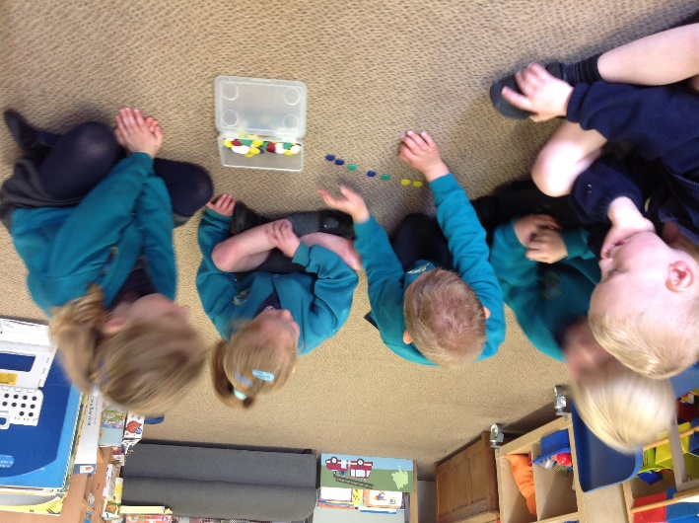
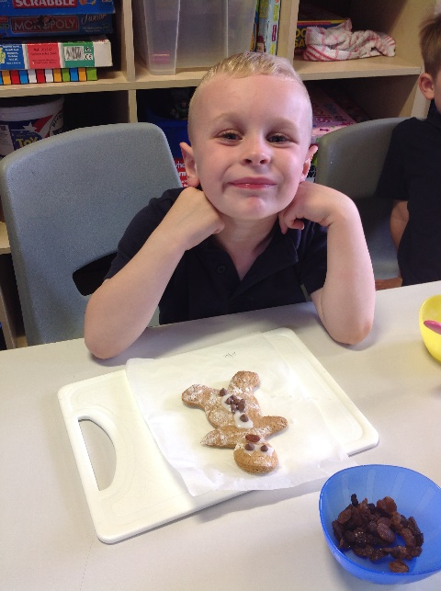
Any Questions?

