Slide 1
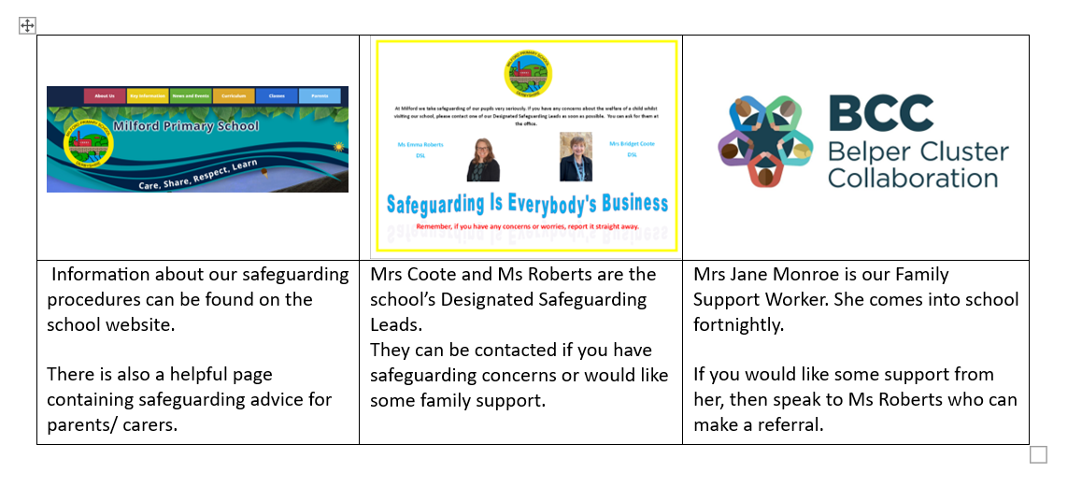
Safeguarding : Help Us To Keep Children Safe

Slide 2
Safeguarding : Help Us To Keep Children Safe
What To Do If Your Child Is Absent From School
If your child is not able to attend school you should contact the office on the morning of the absence by phone, by email or in person. This should be done by 9.45 am.
Please do not contact individual teachers by email to report an absence as messages can be missed.
If a child’s absence is not reported by 9.45am , we will send a reminder text to parents/ carers. If there is no response, we will phone. If we can’t get hold of a parent/ carer we will try other contacts.
If we can’t find out where the child is, we will have to start our safeguarding procedures – which may involve phoning the police or making a home visit.
Please help us to avoid this by reporting absences promptly!

Slide 3
Safeguarding : Help Us To Keep Children Safe
Collection From School
Please return the Picking Up Permission Form that was sent out last week by 22/09/23.
It is important that we have up to date information about who has permission to collect your child from school.
If an adult not on the form is picking up your child, then YOU MUST ring / email the school office and leave a message. The message will then be given to the teacher. Teaching staff are busy and will not always pick-up an email so please contact the office.
Please don’t pass on messages verbally to staff on the school gate as school is a busy place. By contacting the office, you can be sure the message will be safely delivered.

Slide 4
Safeguarding : Help Us To Keep Children Safe
Medicines in School
If your child needs to take medicine - regularly or for a short time - complete a medicines form.
You can collect a form from the office or download one from the website.
All medicine must be clearly labelled with your child’s name.
Take the medicine and the form to the office.
NO MEDICINE WILL BE ADMINSTRATERED IN SCHOOL WITHOUT A COMPLETE FORM.
NEVER LEAVE ANY MEDICINE IN YOUR CHILD’S BOOK BAG.

Slide 5
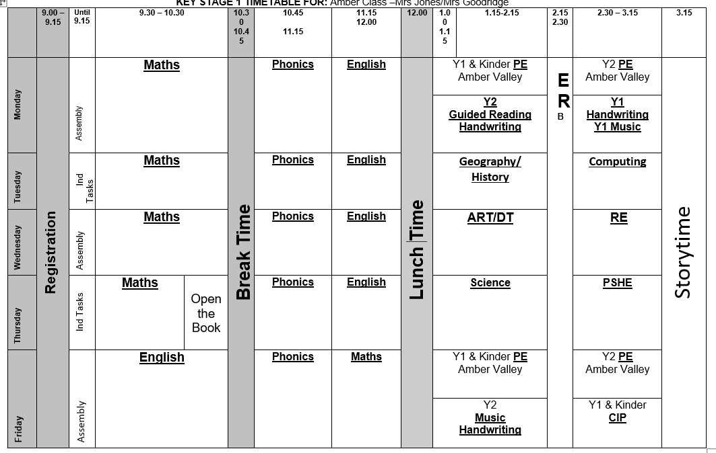

Slide 6
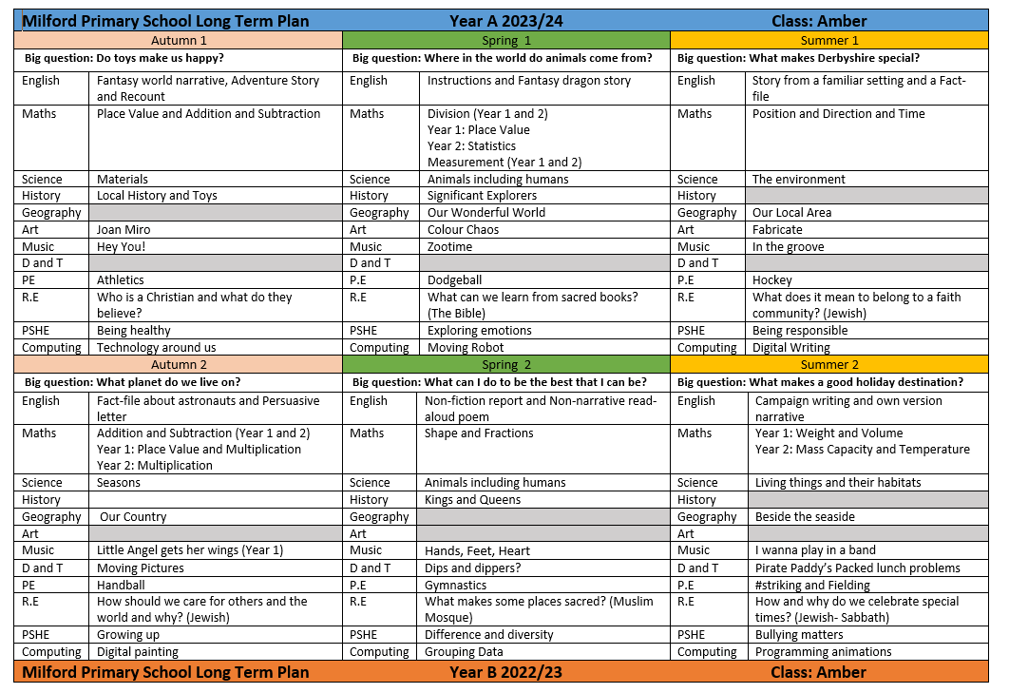

Slide 7







Slide 8

Positive attitudes to reading
Foster a love of reading
Encourage reading for pleasure
Parent-child bond has such a positive effect on your child’s attitude to reading

Slide 9
Daily reading
Set aside time each day to read- at least 3 times a week
Flick through a new book to look at the pictures
Sound out the words through Phonics
Praise your child for trying hard with their reading
Read to your child

Slide 10
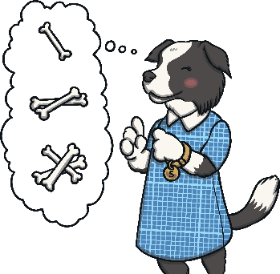



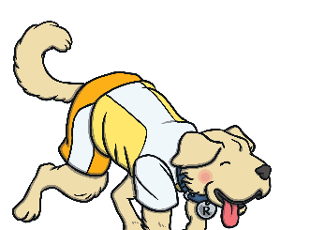
What makes a good reader?
Being able to understand what’s been read
Talk about the text
Inference Iggy
Content Domain 1d:
Make inferences from the text.
Vocabulary Victor
Content Domain 1a:
Draw on knowledge of vocabulary to understand texts.
Sequencing Suki
Content Domain 1c:
Identify and explain the sequence of events in texts.
Predicting Pip
Content Domain 1e:
Predict what might happen on the basis of what has been read so far.
Rex Retriever
Content Domain 1b:
Identify/explain key aspects of fiction and non-fiction texts such as characters, events, titles and information.
Notes:
Introduce parents and carers to the Year 2 SATs using the Totally Pawsome Gang to cover each content domain.

Slide 11
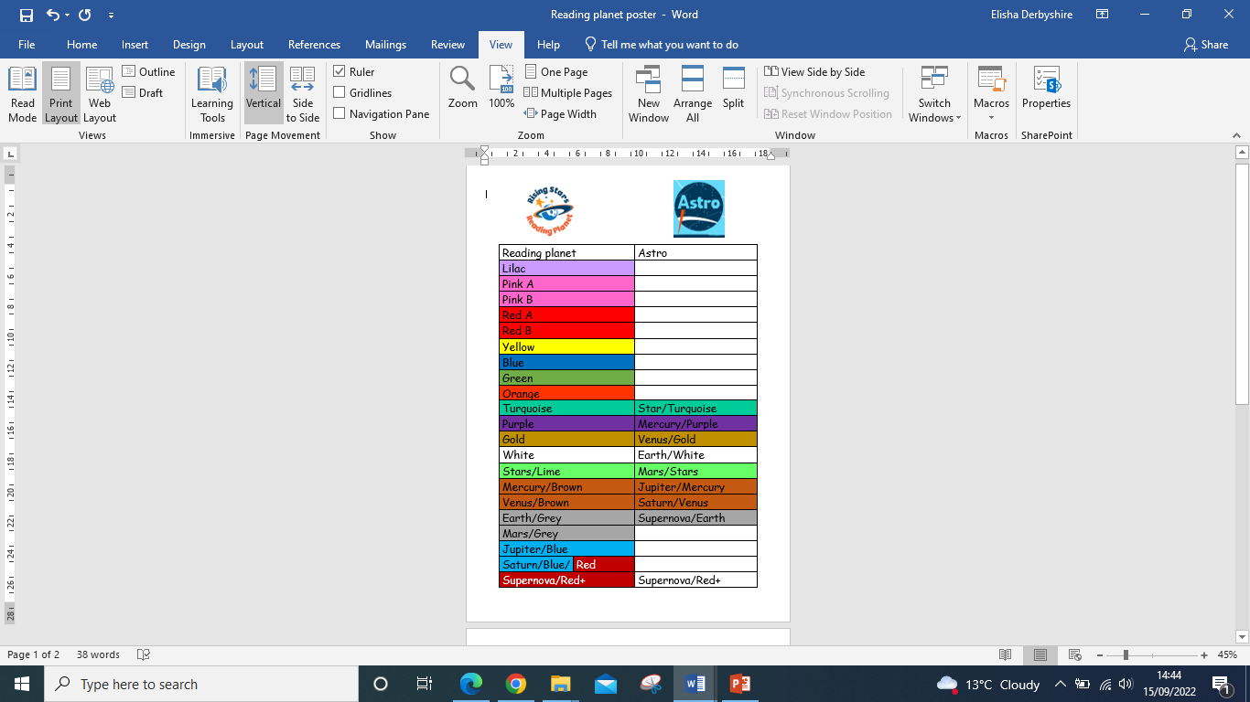
Reading books
Changed weekly on a Monday or if we read with them through the week and find that they are confident reading their books.
Slow, steady and secure
Ensure full understanding
Reading with fluency
We hear the children read in guided reading,
so the teacher doesn’t always hear 1:1 and
record in reading record.

Slide 12


Rocket Phonics
Text based programme with Interactive big books
Pupil Practice Booklets
Follow two part lessons- blending and segmenting
Reading Planet Rocket Phonics: The Teaching Week - YouTube

Slide 13

Rocket Phonics
Reading books are aligned with the scheme
Fully decodable texts that your child can read independently

Slide 14
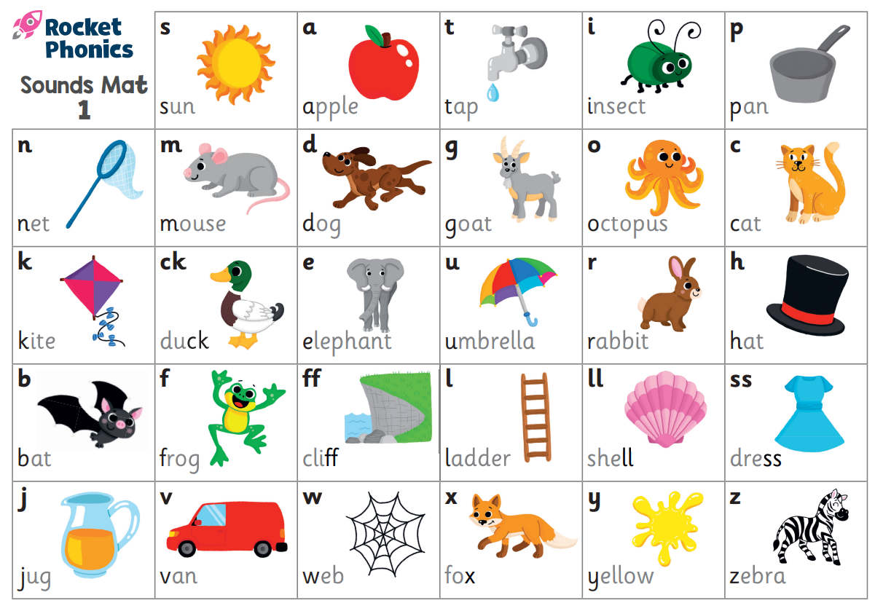
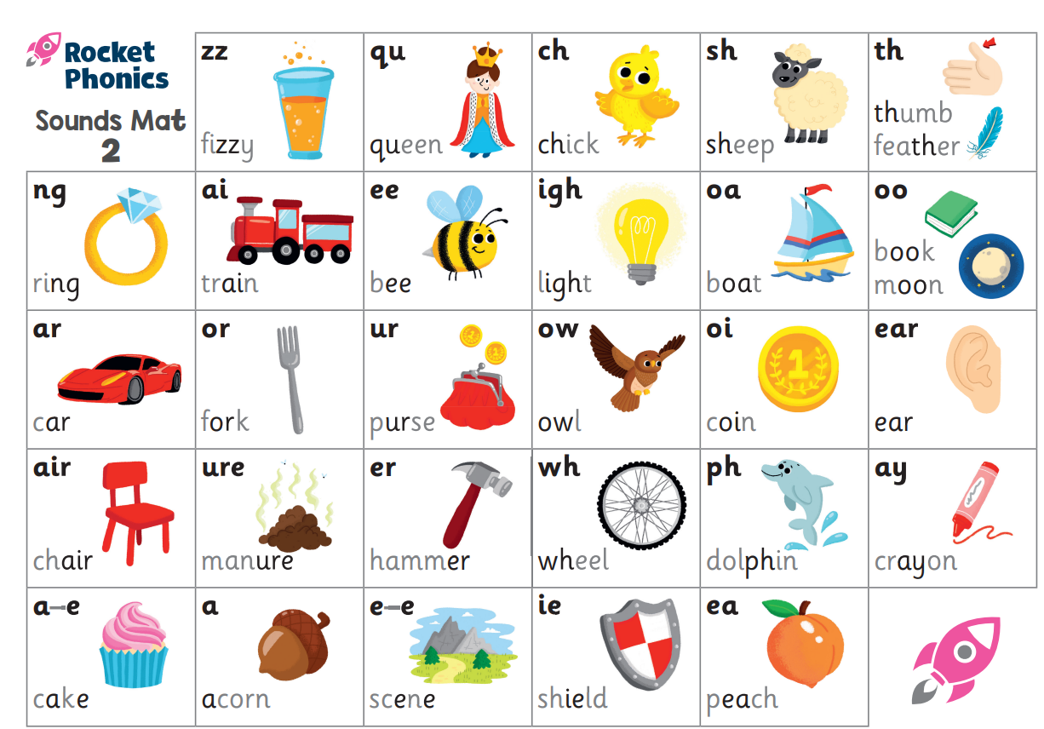
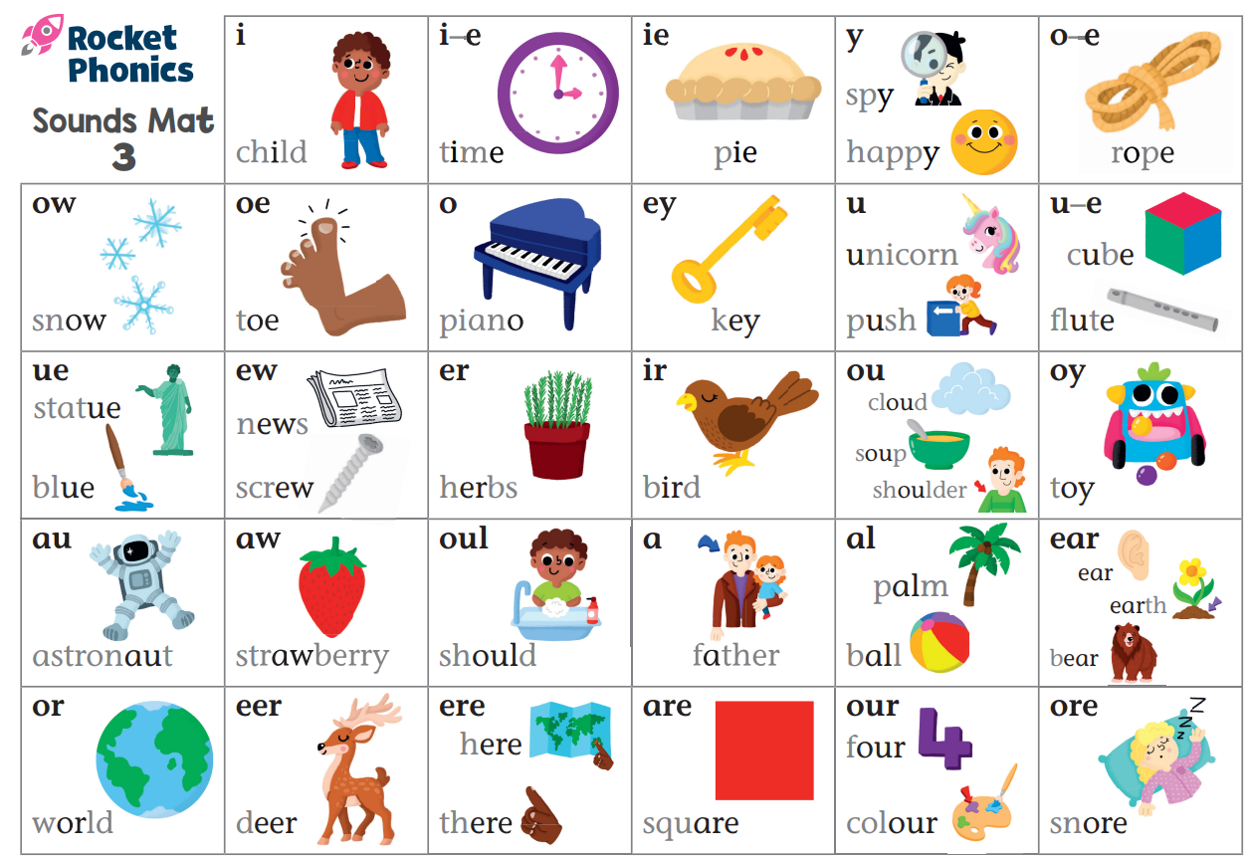
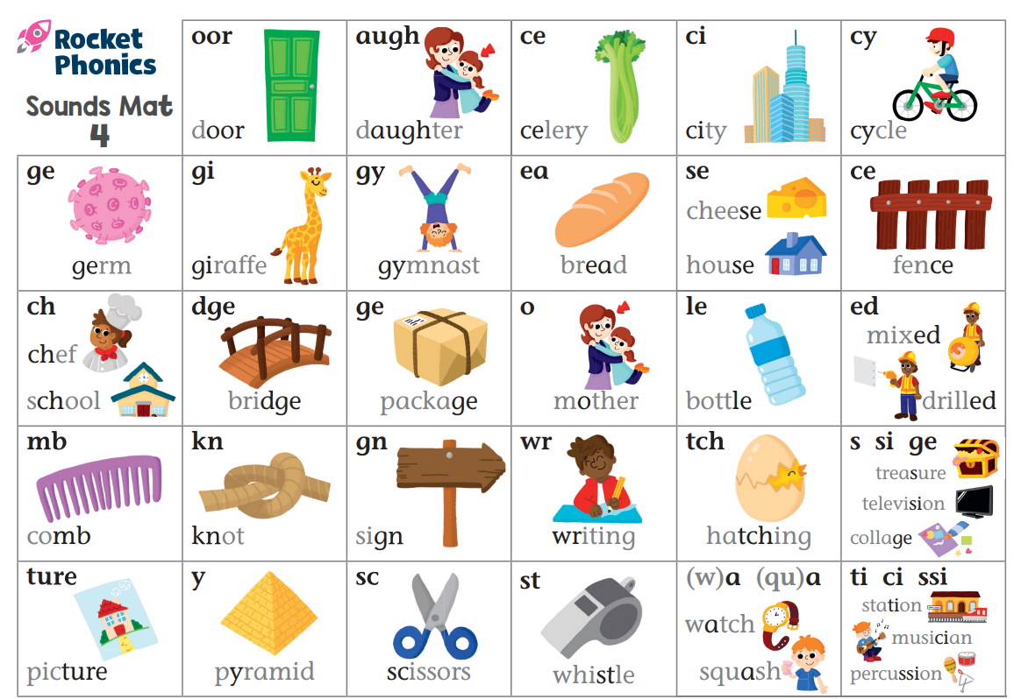
Sound
Mats
Notes:
Highlight the sounds covered and their correct pronunciation.
Share the sound mats that are included in the pack so that parents and carers are able to use them at home to support learning.

Slide 15


Blending and segmenting
Blending for reading – combining the sounds of letters in a word to create the whole word.
ch - i - ck
Segmenting for spelling – breaking down spoken words into their separate sounds.
sh ar p

Slide 16
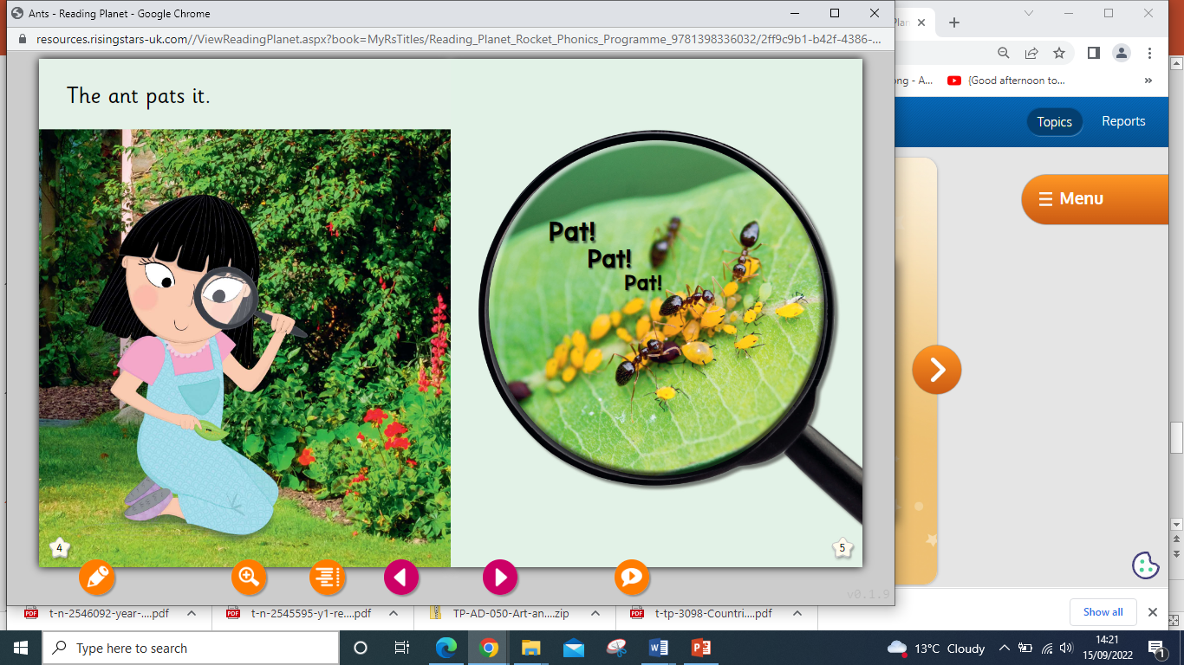
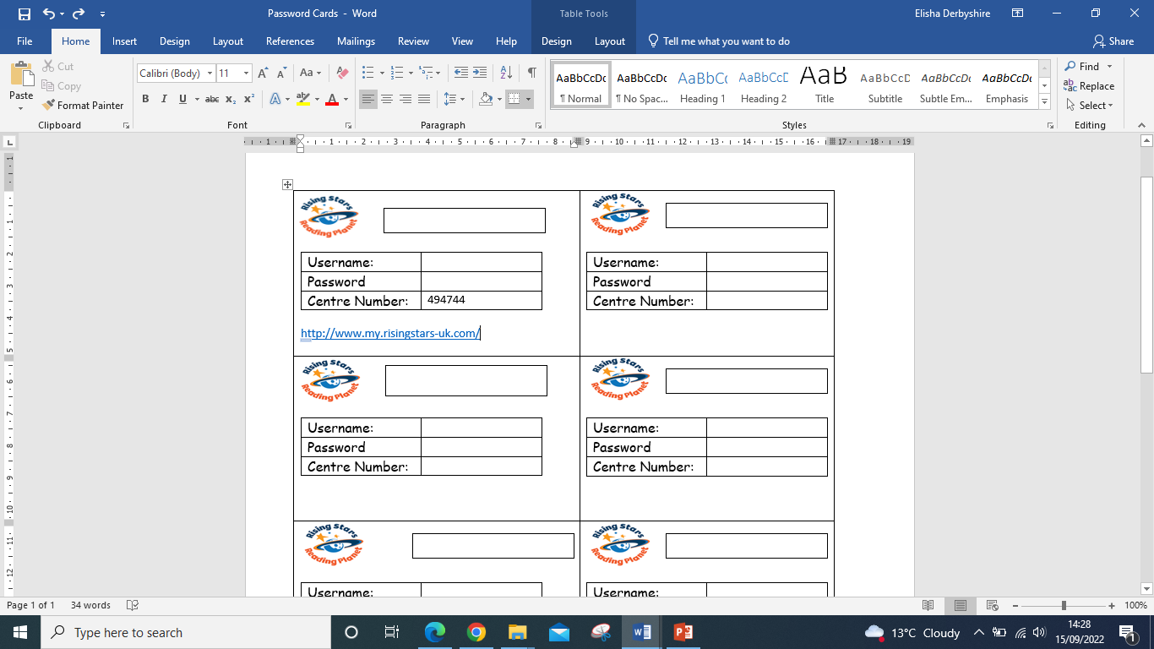
Rocket Phonics
Online learning platform to access e-books, games and resources at home
Your child will receive a new card with a password code next week for the new Boost Learning platform.

Slide 17

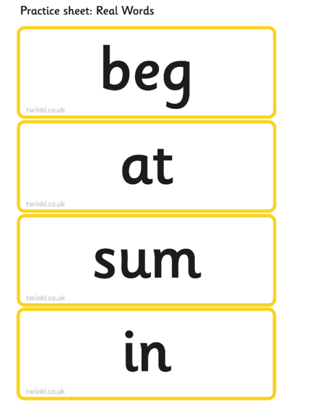
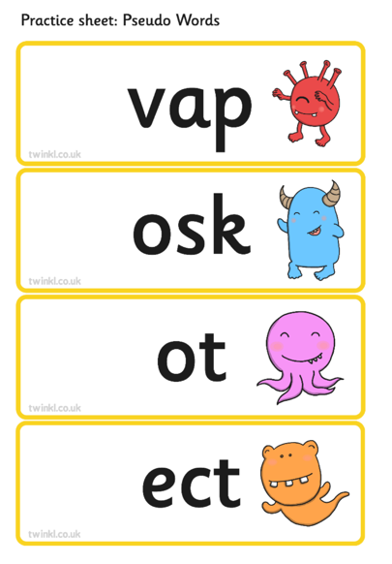
The Phonics Screening Check
The aim of the check is to ensure that each child is making progress
in phonics. Children are expected to read a mixture of real words and ‘nonsense’ words.
Notes:
Show this example of words which could typically be seen in a phonics screening check. Explain that the test includes 40 unseen words that the children need to read. Half of the words are real words and half of the words are pseudo words. Pseudo words (often referred to as ‘nonsense’ or ‘alien’ words) are designed to test pure phonic ability rather than knowledge of commonly seen real words. Examples might include ‘baf’, ‘gip’, ‘leet’, ‘stoof’.

Slide 18
Common Exception Words
Notes:
Share the Year 1 Common Exception Words handout and explain that pupils need to be able to read and spell these words by the end of the year.

Slide 19



Year 2 to Year 6 Spelling Bee
In February 2024 , we will be holding a Year 2-Year 6 Spelling Bee.
There will be a wide range of certificates and prizes.
Words will be taken from the statutory spelling lists for each Key Stage. These can be found on our website. English | Milford Primary School (secure-primarysite.net)
Spellings are practised in school, but why not practise spellings at home too?

Slide 20
Spellings for the term – in reading book
Spelling test will be Friday morning.
Homework – phonics and maths each week that link to what we’ve been learning in school. Please see school website (link on the sheets) for pronunciation of sounds and support.
Homework will be handed out on a Friday and back on a Thursday.
Please don’t bring toys to school.
Please take earings out or cover them with tape on PE days.

