Slide 1

Year 5 and 6 Residential Visit to Mount Cook
21st -23rd October 2024

Slide 2
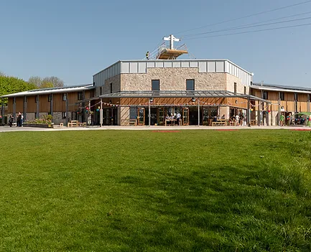
Mount Cook Adventure Centre
Porter Lane
Middleton by Wirksworth
Matlock
Derbyshire
DE4 4LS
Phone: 01629 823702

Slide 3
The aims of the visit
To enable our pupils to engage with outdoor and adventurous activities to meet those elements of our PE Curriculum.
To support our pupils in developing independence, resilience and social skills in a supported environment.

Slide 4
Staffing
Mrs Coote
Miss Latham
Mrs Dodd
Mrs Aldred

Slide 5
Getting there and back
We will be leaving school at approximately 12:30 on Monday 21st October.
All children will need a packed lunch and a good snack. Please pack it in a carrier bag. We will eat our lunches at Mount Cook.
Children should bring kit bags/cases and small bags with them to school in the morning. We will leave these in the hall until departure time. Children MUST be able to carry their luggage for themselves.
Please hand any medication to a member of staff.
We will leave Mount Cook at approximately 1pm on Wednesday 23rd October. They will provide us with a picnic lunch on that day.
We will be back at school well before home time and your child should be collected at 3:30pm as usual.

Slide 6
Activities
Our itinerary looks very exciting. The Y6 children inputted their ideas at the planning stage based on things they had really enjoyed, things they didn’t do last year and planning something for everybody.
We are in 3 groups for the day time activities but we get together for our evening event. All activities are led by qualified instructors.
You can find out more on the Mount Cook Adventure Centre website.

Slide 7
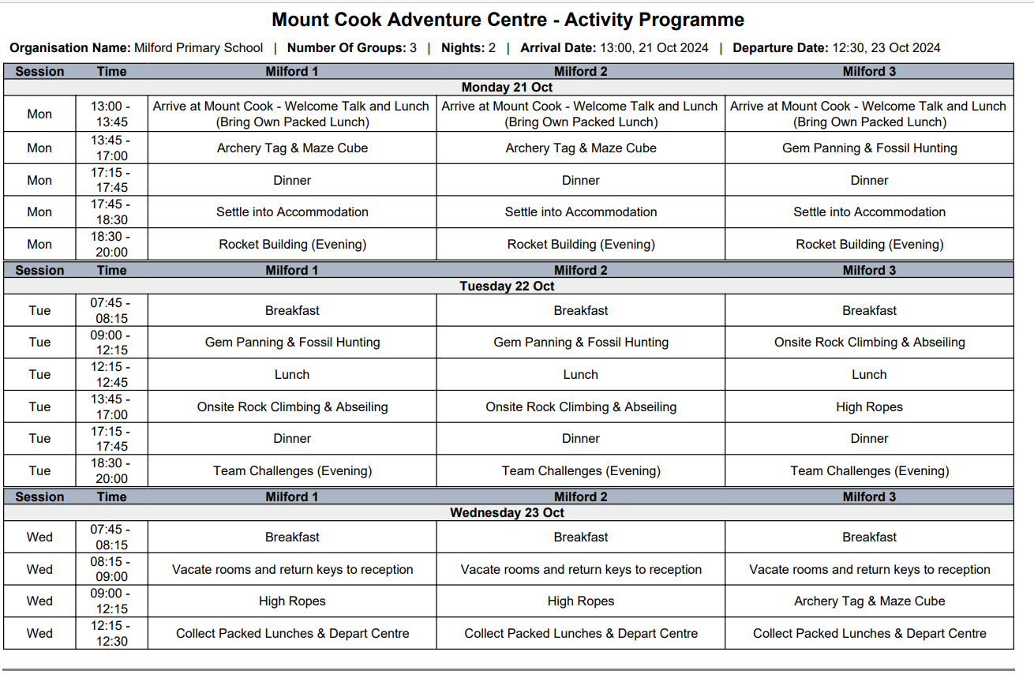

Slide 8
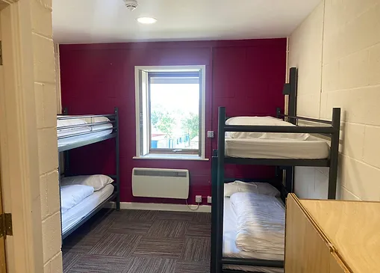
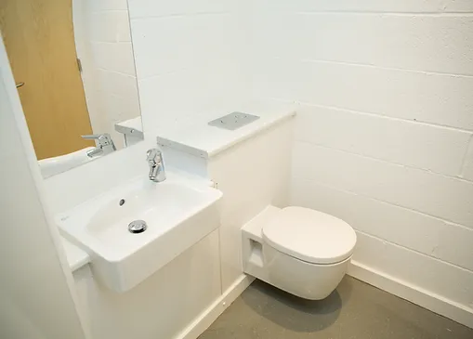
Ensuite Accommodation

Slide 9
Food
Mount Cook Adventure Centre provide home-cooked food throughout the day. You can see some sample menus on the website.
Different dietary requirements can be met with advance notice.
We will always encourage children to eat something.
Please do not send your child with snacks.
On Monday 21st October, all children should bring a packed lunch : we will eat this when we arrive so please send it in a carrier bag rather than a lunch box.
On Wednesday 23rd , the children are provided with a packed lunch from Mount Cook.

Slide 10
Medication
Any medication should be handed in to Mrs Coote or other staff member on Monday 21st October. It should be clearly labelled with the child’s name, dose and frequency/times.
Inhalers will be kept by the group leader in the first aid kit which will be with the group at all times.
Calpol and Piriton will be given if the staff think it is needed, if parents have given permission. Any doses will be recorded.

Slide 11
Emergency Contact
During school hours
Milford Primary School
01332 841316
Out of school hours
Mount Cook
01629 823702

Slide 12
Emergency Contact
No news is good news.
We may contact you direct if we have a concern about your child where we just need a bit of insider information on dealing with a sleep/food/homesickness issue. We will always try first to support your child to deal with this themselves.
If there is an emergency or a delay at our end, you will be contacted through school.

Slide 13
Useful things to bring
Cuddly Toy
Book
Small game: Top Trumps Travel Chess Dobble Uno
A disposable camera
Torch
Spending Money (up to £5)in change in a NAMED wallet/purse/envelope
Water bottle
All in a small backpack to keep it all together for the journey and at the centre.

Slide 14
What not to bring
Snacks: the children will not go hungry and we like to avoid sticky or crumby messes, falling out, choking and allergic reactions. We usually have an emergency packet of plain biscuits.
Any electronics: phones, tablets, cameras, games etc
Expensive/designer clothes Brand new trainers
Anything really precious that would cause real distress if it were lost or damaged.

Slide 15
And lastly….
Talk positively to your child about the upcoming residential.
Address any anxieties they are feeling-however small it may seem.
Reassure them that they will not be forced to do anything they don’t want to do- we will encourage and support them to challenge themselves but never insist.
Let them know that it is OK if their clothes get a bit dirty or wet.
Get them involved in the packing and discuss what they are taking and why. They will have to pack for the return journey so it’s always helpful if they know what they should have and how to fit it in the case.
Get them to practise carrying their bags

