Slide 1



Reading at Milford School

Slide 2
Why?
It is commonly said that a child’s future academic success and job prospects are directly related to their reading proficiency.

Slide 3
Positive attitudes to reading
Foster a love of reading
Encourage reading for pleasure
Parent-child bond has such a positive effect on your child’s attitude to reading

Slide 4
Daily reading
Set aside time each day to read- at least 3 times a week
Flick through a new book to look at the pictures
Sound out the words through Phonics
Praise your child for trying hard with their reading
Read to your child

Slide 5

What to do if your child is stuck?
Use phonics – chunk the word up into sounds
Read to the end of the sentence – what word would make sense?
What is the text about? What word could fit in there?
Does it sound right? Does it look right?
Look at the pictures

Slide 6
Understanding (comprehension)
Being able to understand what’s been read
Talk about the text – the characters, predictions and so on

Slide 7
Phonics
English language is made up of sounds
44 sounds (phonemes)
144 different ways to spelling those sounds
Articulation of Phonemes - YouTube

Slide 8

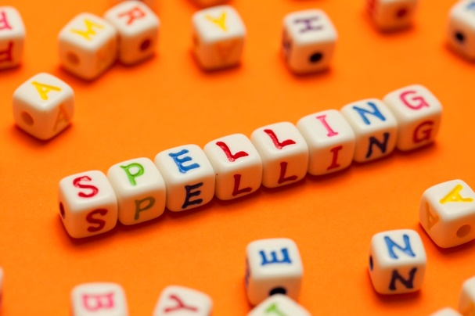
Blending and segmenting
Blending for reading
ch - i - ck
Segmenting for spelling
sh ar p

Slide 9

Rocket Phonics
Following guidance and funding from our local English Hub we are now following the Rising Stars Rocket Phonics Programme
A fully validated Systematic Synthetic Phonics Programme
Introducing Reading Planet Rocket Phonics - YouTube

Slide 10
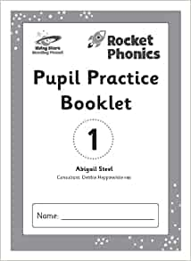
Rocket Phonics
Text based programme with Interactive big books
Pupil Practice Booklets
Follow two part lessons- blending and segmenting
Reading Planet Rocket Phonics: The Teaching Week - YouTube

Slide 11

Rocket Phonics
New reading books are aligned with the scheme
Fully decodable texts that your child can read independently

Slide 12
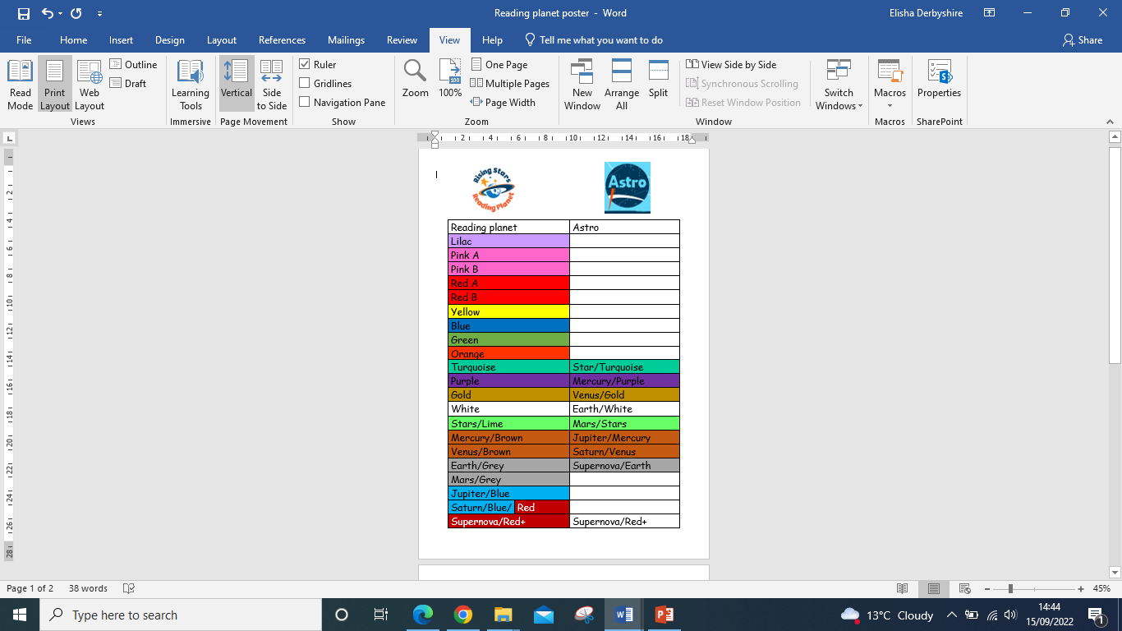
Reading books
Slow, steady and secure
Ensure full understanding
Reading with fluency

Slide 13
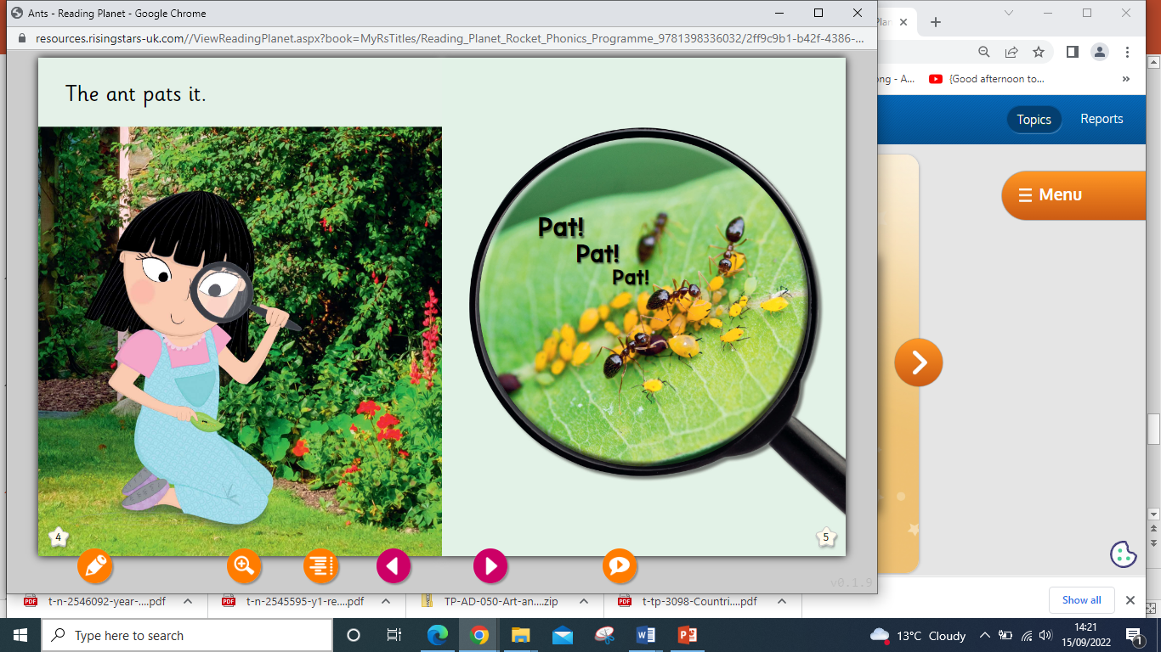
Rocket Phonics
Online learning platform to access e-books at home

Slide 14
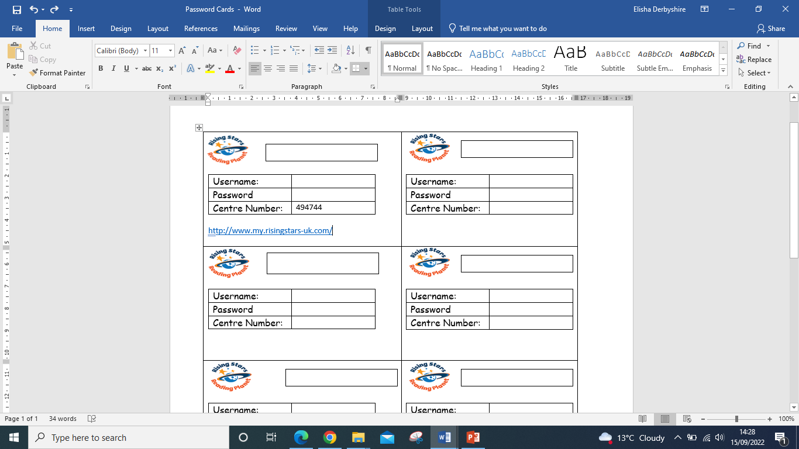
Rocket Phonics
Online learning platform to access e-books, games and resources at home
Your child will receive a password code to access the e-books at home

Slide 15
Thank You!
Questions…..

