Slide 1

Welcome to
Derwent Class

Slide 2
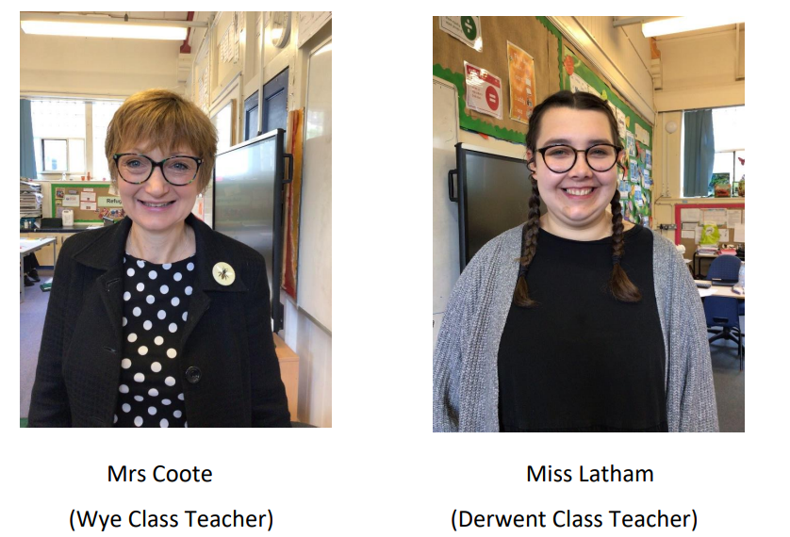
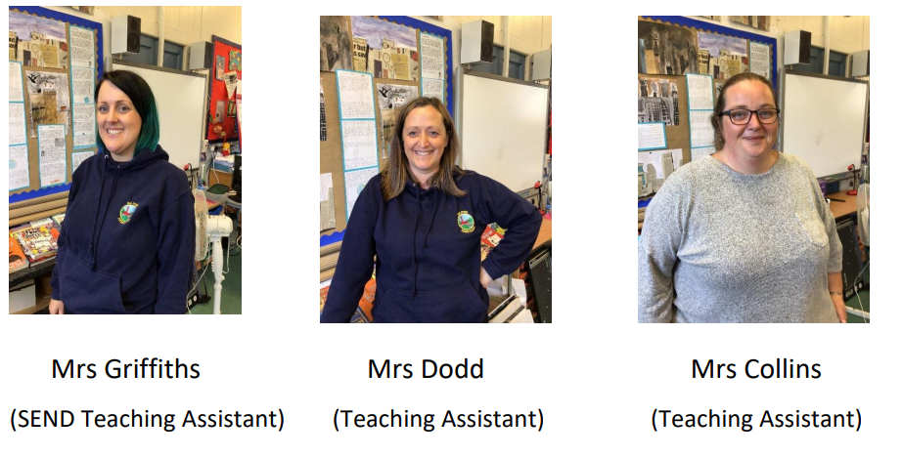
KS2 at Milford
KS2 at Milford is made up of:
- Derwent Class (year 3&4)
- Wye Class (Y5&6)
KS2 Staff:
Miss Latham – Derwent Class Teacher
Mrs Coote – Wye Class Teacher
Mrs Griffiths – Lead Teaching Assistant and Assistant SENDCO
Mrs Collins – Teaching Assistant

Slide 3

Our School Values
*INDEPENDENCE
*CREATIVITY *DETERMINATION
*TOLERANCE
*EXCELLENCE
*KINDNESS
*RESPECT
*RESILIENCE

Slide 4
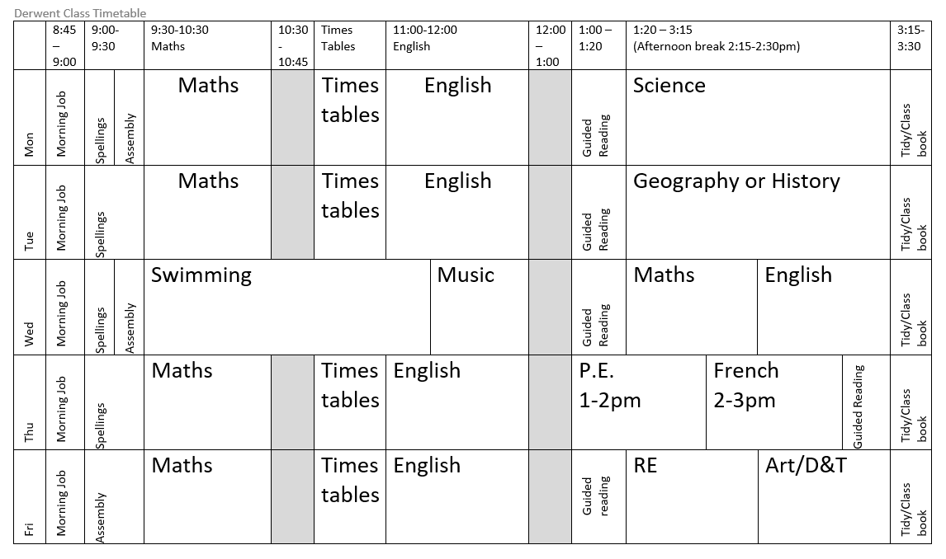
Our Weekly Timetable

Slide 5
Curriculum
Our lessons are designed to meet the National Curriculum.
We use a variety of different schemes to support our teaching. These include:
White Rose Maths,
Literacy Tree,
The Derbyshire Agreed Syllabus for Religious Education
PSHE Matters
National Centre for Computing Education
Lingotot (French)
Twinkl Planit Science
We also write our own lessons and adapt schemes to suit the group of children in the class.

Slide 6
Two new wider curriculum subjects:
French
Swimming

Slide 7

Registration is from 8:55 until 9:05.
We are open from 8:45 and we start learning activities straight away, so it helps to be here bright and early.

Slide 8
Forest School is on Monday afternoons.
Y4 will go in Spring 1
Y3 will go in Summer 1
PE
On Wednesdays, children will go swimming at Belper Leisure Centre, taught by Miss Latham and 2 qualified swimming teachers.
On Thursdays, children will have a PE lesson in school. This lesson will be taught by a sports coach and supported by a Teaching Assistant.
On PE days, the children should wear their PE kit and bring a water bottle.
Milford Primary School
PE Kit
White or navy T-Shirt
Navy or black shorts or joggers
Navy sweatshirt or hoodie
Trainers

Slide 9
Year 4
Multiplication
Tables
Check
Daily times tables practice
Songs
Games
Beat the Teacher
TT Rockstars
Monday 3rd – Friday 14th June 2024

Slide 10
Support with Learning
Children can be supported within class in a number of ways.
One to one or small group support from the teacher.
One to one or small group support from a Teaching Assistant.
Having a learning buddy
Adapted task to revisit earlier learning steps.
Equipment to support success in a task
We have a wonderful team of Teaching Assistants who run a range of one to one or small group interventions in the Zone.
Socially Speaking
Dyslexia Interventions
Lego Therapy
Nurture
Maths Support
Which are tailored to the needs of individual children.

Slide 11
Well-being
The well-being of each of our pupils is central to everything we do at Milford Primary School.
In Derwent Class we offer opportunities for pupils to support their own well-being but also offer support through
Specific lessons about mental health and well-being in PSHE
Open Door: opportunity every day to talk to an adult
Regulation Station: a place where children can choose to go to calm down or take a breath.
A postal system for writing a note to an adult or it can be fed anonymously to our worry monster.

Slide 12
Please stay in touch
We are always able to help our pupils most effectively when school and home work together. We may contact you to discuss any concerns we have about your child in school so that we can plan together about how to best support them. It is always helpful for us to know if there is a change or upset at home. We will always treat information confidentially.
If you think your child needs additional support or are concerned about their progress or well-being, please make an appointment to discuss your concerns.

Slide 13
Homework
Homework is set on Friday each week and is due in the following Friday.
*Green Book:
3 x spelling lists
3 x times tables practise (or TT Rockstars)
*Reading: aloud to an adult, a pet or a toy or to themselves. Record reading in planner to claim housepoints.
*10 minute tasks for Maths and English

Slide 14
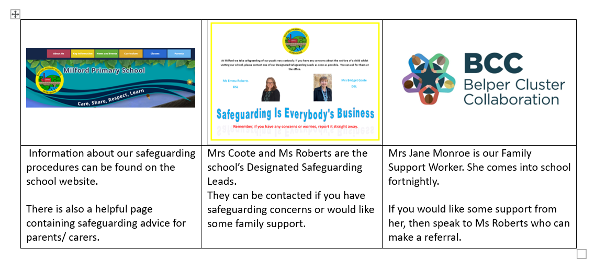
Safeguarding : Help Us To Keep Children Safe

Slide 15
Safeguarding : Help Us To Keep Children Safe
What To Do If Your Child Is Absent From School
If your child is not able to attend school you should contact the office on the morning of the absence by phone, by email or in person. This should be done by 9.45 am.
Please do not contact individual teachers by email to report an absence as messages can be missed.
If a child’s absence is not reported by 9.45am , we will send a reminder text to parents/ carers. If there is no response, we will phone. If we can’t get hold of a parent/ carer we will try other contacts.
If we can’t find out where the child is, we will have to start our safeguarding procedures – which may involve phoning the police or making a home visit.
Please help us to avoid this by reporting absences promptly!

Slide 16
Safeguarding : Help Us To Keep Children Safe
Collection From School
Please return the Picking Up Permission Form that was sent out last week by 22/09/23.
It is important that we have up to date information about who has permission to collect your child from school.
If an adult not on the form is picking up your child, then YOU MUST ring / email the school office and leave a message. The message will then be given to the teacher. Teaching staff are busy and will not always pick-up an email so please contact the office.
Please don’t pass on messages verbally to staff on the school gate as school is a busy place. By contacting the office, you can be sure the message will be safely delivered.

Slide 17
Safeguarding : Help Us To Keep Children Safe
Medicines in School
If your child needs to take medicine - regularly or for a short time - complete a medicines form.
You can collect a form from the office or download one from the website.
All medicine must be clearly labelled with your child’s name.
Take the medicine and the form to the office.
NO MEDICINE WILL BE ADMINSTRATERED IN SCHOOL WITHOUT A COMPLETE FORM.
NEVER LEAVE ANY MEDICINE IN YOUR CHILD’S BOOK BAG.

Slide 18

Medical
Please ensure we are aware of any medical needs or allergies your child may have.
We can administer medicine, such as inhalers, if a medical form is completed and given to the office.
If a child has an accident and first aid is given, they will be given an accident slip that will be sent home and/or we will inform you at the end of the day.

Slide 19



Year 2 to Year 6 Spelling Bee
In February 2024 , we will be holding a Year 2-Year 6 Spelling Bee.
There will be a wide range of certificates and prizes.
Words will be taken from the statutory spelling lists for each Key Stage. These can be found on our website. English | Milford Primary School (secure-primarysite.net)
Spellings are practised in school, but why not practise spellings at home too?

Slide 20

Any Questions?

